Slide 1
APL Game project
Submitted By:
Md. Mahfujur Rahman
Id : 011161156
Sec : NA
Submitted To:
Mahbuba Afrin
Lecturer, dept. of CSE
UIU

Slide 2
PROJECT
HUNGRY BIRD

Slide 3
FETURES:
There is hungry Bird
There are lots of enemy
There are few foods
Eating its food without touching enemy
If successfully eat its food you will win the game
If touch the enemy game will be over

Slide 4

HOME PAGE

Slide 5
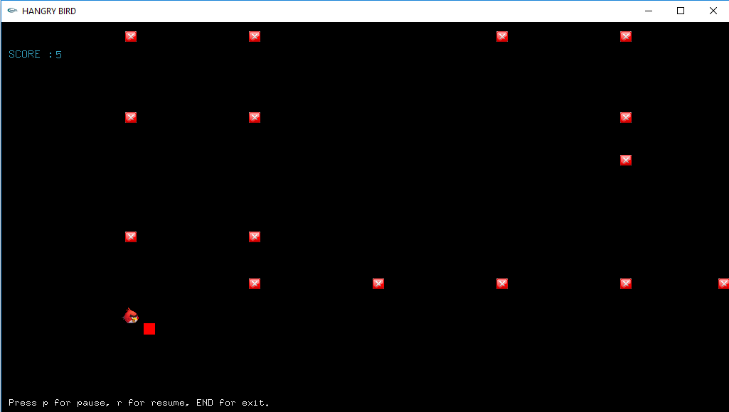
Eating FOOD

Slide 6
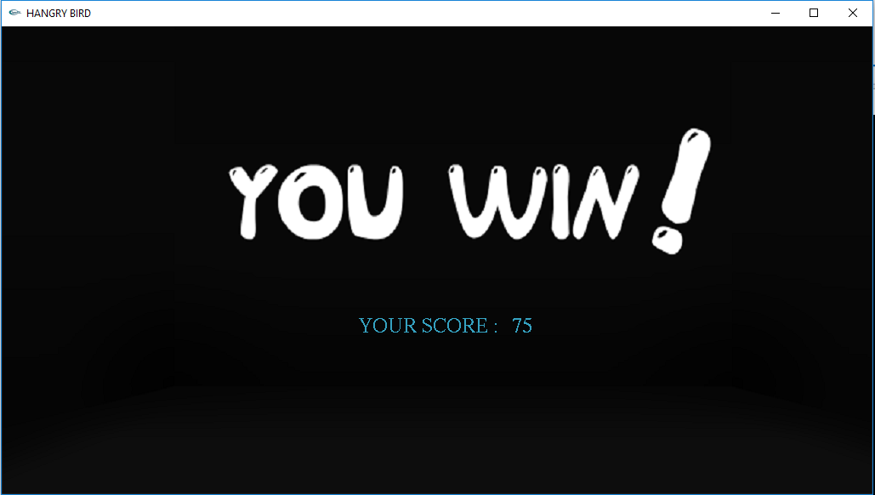
CONGRATULATION

Slide 7
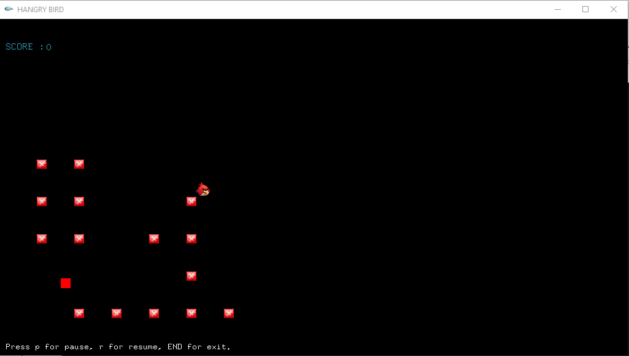
DIE………!

Slide 8
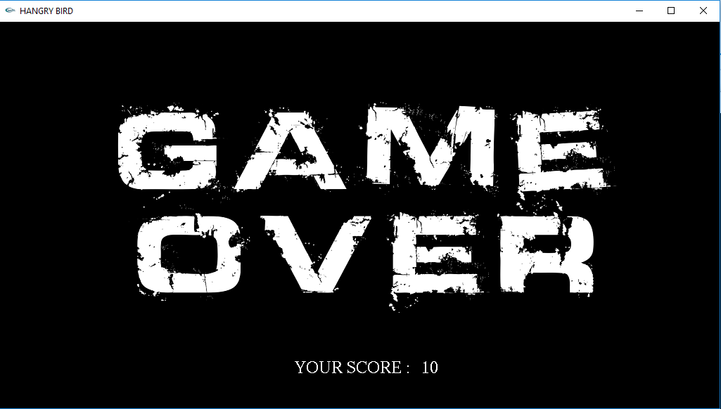
GAME OVER

Slide 9
FUTURE IMPLEMENTATION
SET more new level
May be Add easy mood, normal mood & hard mood

Slide 10
THANK YOU

